Slide 1


RekogNail: automatic product thumbnails on AWS
Group 3
Londiwe Ngema · Tumelo Mathenjwa · Magala Ratsoma · Nhlanhla Malaza
Notes:
Time: 1 min.
Good morning judges and mentors. We are Group 3 presenting SmartThumb SA, built for the Praesignis AWS Hackathon Stage 1. Team members are Londiwe Ngema, Tumelo Mathenjwa, Magala Ratsoma, and Nhlanhla Malaza. We built a zero-maintenance serverless pipeline that turns raw smartphone product photos into clean, optimized catalog thumbnails automatically.

Slide 2

01 · THE PROBLEM
Messy phone photos make catalogues hard to manage
Small and informal South African merchants photograph inventory directly on smartphones for WhatsApp Business, Instagram, and local storefronts.
Manual cropping, resizing, and renaming on mobile devices is tedious, error-prone, and steals hours from selling.
Inconsistent file weights and mismatched aspect ratios slow down customer storefronts and degrade catalog appearance.
Notes:
Time: 1 min.
In South Africa, thousands of township and informal micro-enterprises run their commerce entirely through WhatsApp and social channels. Merchants take raw photos on whatever smartphone they have. High-resolution multi-megabyte photos bog down chats and mobile data bundles. Resizing them manually takes valuable trading time and leads to messy, inconsistent product galleries.

Slide 3

02 · THE SOLUTION
Upload a photo, get a thumbnail automatically
An event-driven serverless pipeline that handles image lifecycle with zero manual intervention.
01
02
03
04
1. Seller uploads raw photo
2. Event triggers Lambda
3. Output stored cleanly
4. Smart categorization
Amazon Rekognition labels inventory objects (e.g. Shoes, Apparel) to assist catalogue search.
JPG or PNG image drops directly into a private Amazon S3 source bucket.
S3 event fires an isolated Python 3.12 worker using Pillow to resize to max 300×300 preserving aspect ratio.
Processed thumbnail lands in a dedicated output bucket, isolated from incoming uploads.
Core architecture vs. demo layer: The S3-to-Lambda pipeline is the production product and operates fully headless without any frontend. The browser interface is strictly a testing and evaluation harness.
Notes:
Time: 1 min.
"Our backend solution is fully automated. The moment a seller uploads a product photo, our system instantly triggers a background workflow. It automatically resizes the image into a clean, perfectly proportioned thumbnail, saves it securely, and uses smart AI to scan and auto-tag the item. Crucially, this entire engine operates entirely in the background, meaning it is independent, lightning-fast, and ready to scale effortlessly."

Slide 4
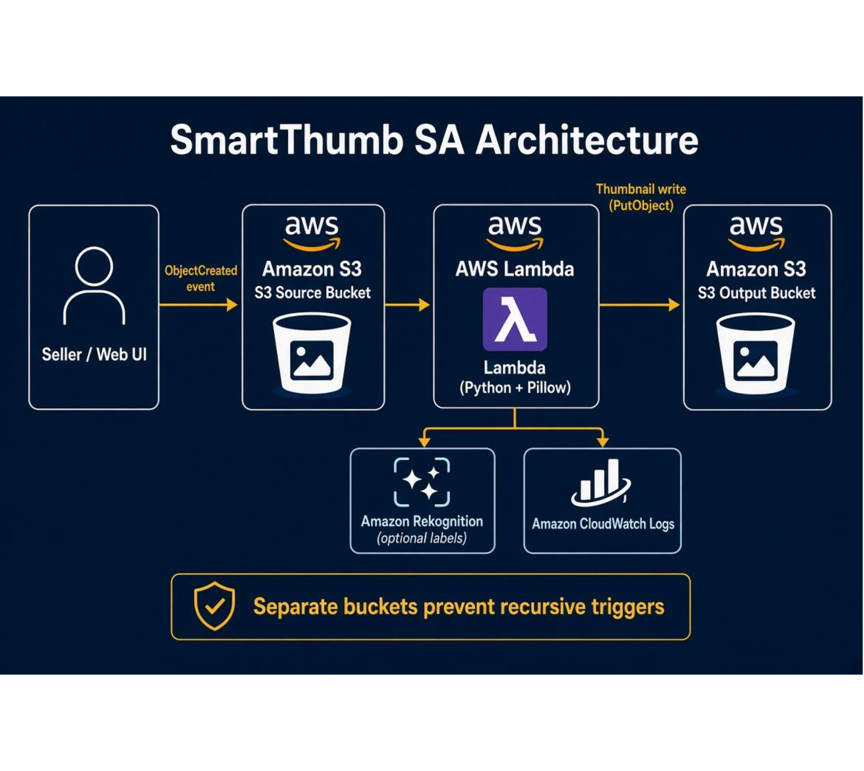
03 · ARCHITECTURE
Two buckets, one event, no recursion
Writing thumbnails back to the trigger bucket is a classic serverless failure mode that creates infinite bill-inflating loops. SmartThumb SA physically isolates incoming and processed media.
Demo Lane
API Gateway powers the demo web interface to trigger uploads and inspect live CloudWatch execution traces.
Notes:
Time: 1 min.
To guarantee architectural resilience, we focused heavily on preventing a classic serverless pitfall: infinite loop triggers. If a system saves a processed image back into its original folder, it can accidentally re-trigger itself indefinitely, creating massive cost spikes. We eliminated this risk entirely by decoupling our event storage , creating a strict one-way path from a private ingestion bucket to a separate thumbnail output bucket.
Security is baked in from day one using strict, least-privilege access controls, and everything is monitored seamlessly in the background. Finally, we deployed an API Gateway-powered Demo Lane. This gives us real-time visibility, allowing you to trigger a live upload right now and watch the system process the data safely and instantly.

Slide 5
LIVE DEMONSTRATION
Live Demo
Switching to running application
Notes:
Time: 3 min.
We are now switching to the running web UI to demonstrate the live pipeline. We will upload an uncompressed smartphone product photo, inspect the immediate S3 event trigger, examine the 97.1% payload reduction, review CloudWatch logs, and view auto-generated Rekognition catalog tags.

Slide 6






04 · AWS STACK
Built on six AWS services
Amazon S3
AWS Lambda
AWS IAM
Private source and output buckets; event trigger.
Python 3.12 + Pillow.
Least-privilege role.
Amazon CloudWatch
Amazon Rekognition
API Gateway
Logs.
Optional labels (e.g. Car, Wheel, Tire).
Demo UI only.
Status: full upload-to-thumbnail pipeline working; example 97.1% size reduction; web UI with Upload, Gallery, Logs and Test suite tabs showing original and thumbnail size, processing time and request ID; tester tracking.
Notes:
Time: 1 min.

Slide 7
05 · RETROSPECTIVE
Challenges and lessons learned
ENGINEERING CHALLENGES
ARCHITECTURAL LESSONS
Loop Prevention & IAM Scope
Decoupling UI from Processing
Preventing recursive invocations required strict physical bucket separation rather than prefix filtering.
Treating the pipeline as a standalone engine ensured the core product functions independently of web clients.
Binary Packaging in Lambda
Observability as a First Step
Packaging C-dependent image libraries (Pillow) required creating clean Linux-compatible layer artifacts.
Structured CloudWatch logging from day one turned silent permission failures into fast, solvable debug cycles.
Notes:
Time: 1 min.
During the hackathon we tackled several real-world engineering hurdles. First was recursive triggers: physical bucket segregation proved far safer than relying on S3 key prefix rules. Second was scoping IAM down from broad wildcards to strict least-privilege resource ARNs. Third was packaging Pillow C-bindings cleanly for Lambda ARM64/x86 runtimes.

Slide 8




06 · CONCLUSION & ROADMAP
A working serverless pipeline, with clear next steps
Stage 1 delivered a production-ready core engine; Stage 2 expands delivery formats and merchant tooling.
Current Baseline
Multi-Resolution Output
Automated 300×300 thumbnail generation and S3 storage active.
Generate banner, card, and icon preset bundles simultaneously.
WhatsApp & WebP Optimization
Automated Catalogue Folders
Compress directly to modern WebP for micro-data usage in WhatsApp.
Route images into S3 prefix trees derived from Rekognition labels.
Notes:
Time: 2 min including Q&A.
To conclude: our core serverless thumbnailing engine is verified, production-grade, and works without any UI dependency. For Stage 2, our roadmap targets multi-size generation, WebP compression tailored for WhatsApp data savings, automated S3 folder organization powered by Rekognition labels, and SNS failure alerts.

Slide 9
SMARTTHUMB SA · AWS HACKATHON
Questions?
Thank you for your time and feedback.
GROUP 3 PROJECT TEAM
Londiwe Ngema · Tumelo Mathenjwa · Magala Ratsoma · Nhlanhla Malaza
Notes:
Time: 1 min.
Thank you to Praesignis, the mentors, and the judges. We are now open for any technical questions regarding our architecture, Lambda configuration, IAM scoping, or Stage 2 expansion plans.

